Slide 1

Computational study of thiophene via
ab initio electronic structure calculations
Seveli Kaur | 22057019

Slide 2

Computational study of thiophene via
ab initio electronic structure calculations
Department of Chemistry, IIT BHU
Presented by -
Seveli Kaur|22057019
Supervisior -
Dr. V. Ramanathan
02

Slide 3
OVERVIEW
05
Future Scope
01
Introduction
09
06
Acknowledgement
02
Computational Details
10
03
Result
07
11
04
Conclusion
08
03
Notes:
Flow of our discussion

Slide 4
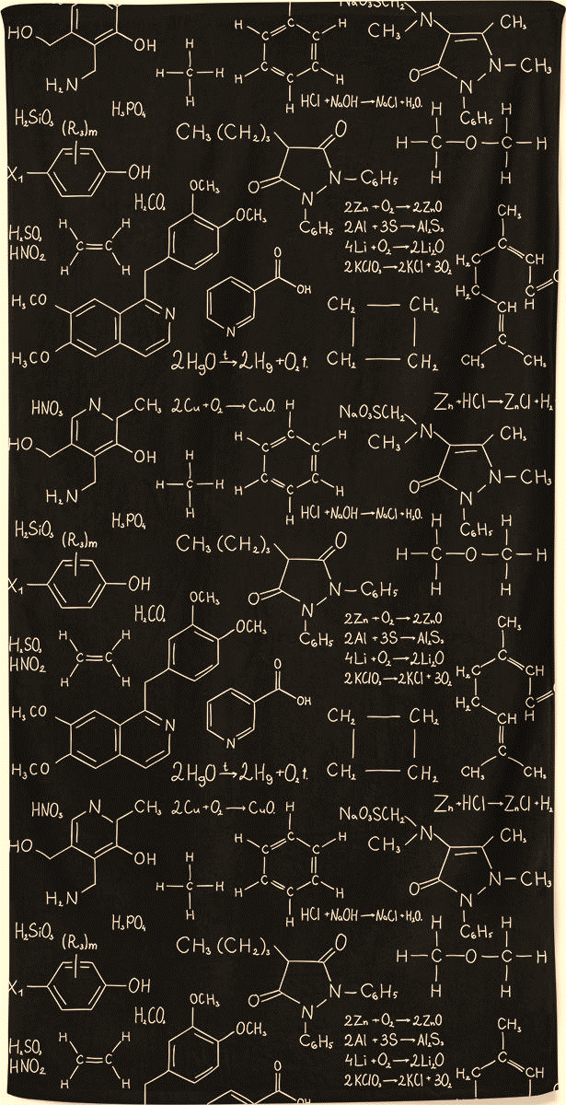
INTRODUCTION
Thiophene is a versatile compound with aromatic properties and exceptional electronic characteristics.
It has gained considerable interest in material chemistry, electronics, optoelectronics, and medicinal chemistry.
04

Slide 5
-Thiophene polymers and oligomers are promising for conductive, optical, and biomedical applications.
-Incorporating thiophene units into polymers can modify their thermomechanical properties.
-This presentation delves into the intermolecular interactions of thiophene dimers, focusing on π-stacking phenomena.
-Computational methods like DFT and MP2 are utilized to study electrostatics, dispersion, and charge-transfer interactions in thiophene dimers.
05

Slide 6

COMPUTATIONAL DETAILS
All computational calculations were performed using the Gaussian 16 suite of programs
First, the geometry of the thiophene monomer was optimized at each level of theory and basis set combination listed below.
DFT Functionals:
- B3LYP, B3PW91, wB97XD, mPW1PW91, PBEPBE
Ab Initio Method:
- MP2 (Second-order Møller–Plesset perturbation theory)
06

Slide 7
BASIS SET
Different basis sets were utilized for the calculations to assess basis set dependence and accuracy of the results:
- 6-31G, cc-pVTZ, CC-pVDZ, 6-311+G(d,p), 6-311++G(d,p) and CC-pVQZ
The optimized monomer geometry was used as the input structure for subsequent dimer calculations.
07

Slide 8

RESULT
Energy order within the Same orientation
The Computed optimized geometrical parameter and interaction energies(Eint) for different orientations of the thiophene dimer at various levels of theory and basis sets are presented in Table 1a, Table 1b, Table 1c and Table 2.
The interaction energies in table 2 are listed in ascending order within each orientation to analyze the stability and presence of specific dimer configurations.
09
Notes:
Shown in terms of energy order within the same orientation and an overall energy order.

Slide 9
TABLES
Table 1a, Table 1b and Table 1c : Calculated optimized geometrical parameters of monomer of thiophene at various level of theory.
Bond Length(A) | M1 MP2/6-311++G(d,p) | M2 MP2/CC-PVDZ | M3 DFT/wB97XD at 6-311++G(d,p) | M4 DFT/b3LYP at 6-311++G(d,p)
C1-S | 1.713 | 1.726 | 1.722 | 1.733
C1-C2 | 1.382 | 1.388 | 1.362 | 1.366
C2=C3 | 1.421 | 1.427 | 1.425 | 1.427
C1-H6 | 1.082 | 1.091 | 1.080 | 1.079
C2-H7 | 1.082 | 1.093 | 1.082 | 1.082
Table 1a. Geometric parameters(bond length) of monomer
9

Slide 10
Bond Angle(⁰) | M1 MP2/6-311++G(d,p) | M2 MP2/CC-PVDZ | M3 DFT/wB97XD at 6-311++G(d,p) | M4 DFT/b3LYP at 6-311++G(d,p)
ѲC1-S-C4 | 92.15 | 91.99 | 91.64 | 91.48
Table 1b. Geometric parameters(bond angle) of monomer
Bond length[A] | Pl1 MP2/6-311++G(d,p) | Pl2 MP2/CC-PVDZ | TS1 MP2/6-311++G(d,p) | TS2 MP2/CC-PVDZ | ST1 DFT/ wB97XD at CC-pvDZ
S1-S2 | 4.79 | 4.48 | 4.30 | 4.44 | 4.62
X-X/X-H5 | 3.70894 | 3.80229 | 2.56767 | 2.52680 | 3.89505
ѲS-X-X | 104.90759 | 99.18732 | 92.21726 | 96.18018 | 101.70255
Where M represents a monomer unit
Pl is parallel orientation,
TS is T- shape orientation, St is stacked orientation and X is ghost atom
Table 1c. Geometric parameters(bond length and bond angle) of dimer
10

Slide 11
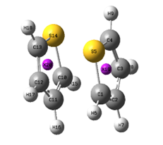
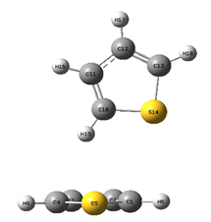
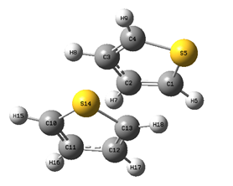
FIGURES
Figure 1a represents the parallel orientation, Figure 1b depicts the T-shaped orientation, and Figure 1c displays the stacked orientation of thiophene dimer
Figure 1a
Figure 1b
Figure 1c
11

Slide 12
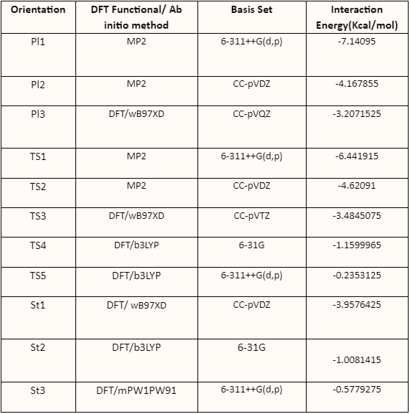
RESULT TABLES
Calculated optimized interaction energy of dimer of thiophene at various level of theory.
12
Notes:
Based on this data it was concluded that

Slide 13
CALCULATION OF INTERACTION ENERGY OF THIOPHENE DIMER
The interaction energy E_{int} of the thiophene dimer was calculated using the formula:
E_{int} = E_{dimer} - 2 *E_{monomer}
where:
- E_{dimer} is the total energy of the thiophene dimer.
- E_{monomer} is the total energy of a single thiophene molecule (monomer).
The interaction energies were calculated for different orientations of the thiophene dimer to understand the nature of intermolecular interactions and orientation dependence.
13

Slide 14

CONCLUSION
The observed Interaction Energy of Thiophene Dimer Orientations follows the following order:
Parallel < T-shape < Stacked
14

Slide 15
FUTURE SCOPE
The pi-pi interaction in thiophene-like systems remains unexplored, and future studies could involve using more complex molecules to investigate this phenomenon. Additionally, exploring the effects of different solvents and incorporating substitutions in both the monomer and dimer of the molecule could provide valuable insights.
15

Slide 16

THANK
YOU

